Slide 1
Crunchbase
Jumana Nadir
Jacky Chow
Jerry Huang
Team- AI Insight

Slide 2


Introduction
Crunchbase Enterprise Prediction
Success and Failure prediction model for the San Francisco Bay Area startups.

Slide 3
Business Value & Business Case
VCs investing model
Enterprise profitable prediction model
Predict Future outcomes with early performance data.

Slide 4
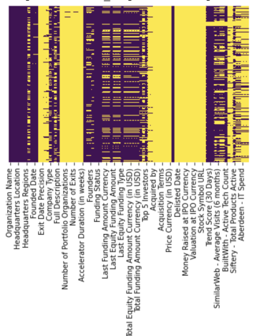
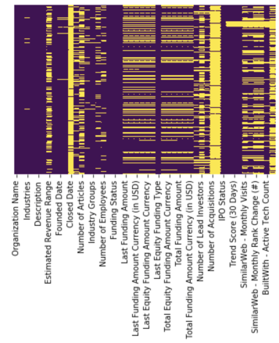
Data Preparation
Crunchbase Enterprise paid service to get more valuable insights to the data.
Dropping features that don't explicitly impact success or failure rate (Website URL, description, Stock Symbol etc)
Missing Values

Slide 5
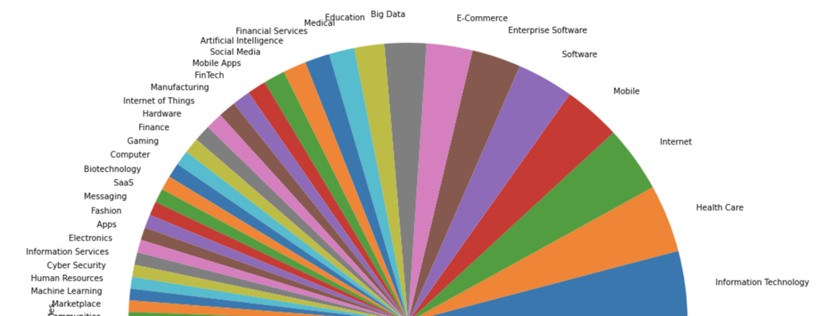
Data Visualization
Industry groups in Bay Area Startups

Slide 6

Assumption
If LastFundingDate < 2.5 years = CLOSED
Given :
Operating Status
Active
Closed
Defined:
Status_new
0= Closed
1= acquired/IPO
2= Active

Slide 7
Target Definition
Company need to have a continue raised funding on each funding rounds.
Company need to have a at least funding money by the size of the company
Companies on ‘active’ assumption which satisfied those two condition will set as Success: 1
Rest companies will set as Fail: 0 (expect the ‘acquired/IPO’ companies on assumption)

Slide 8
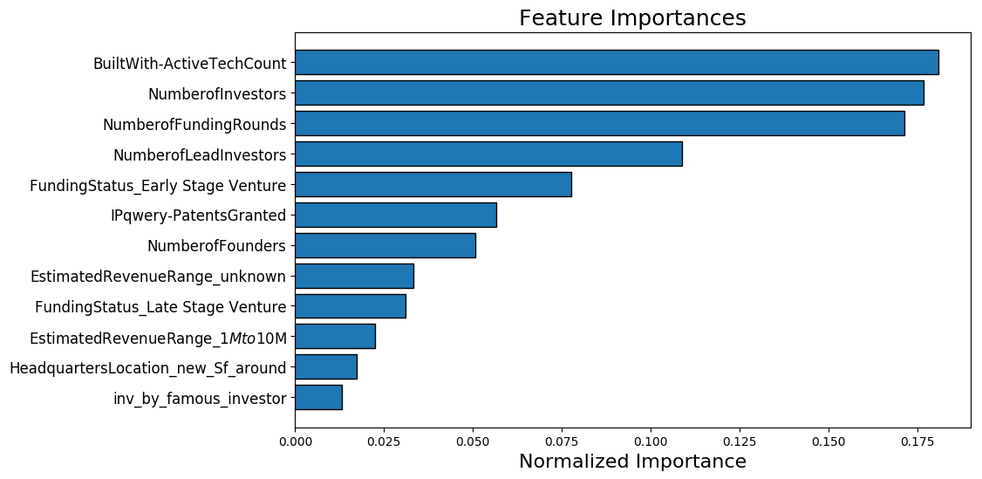
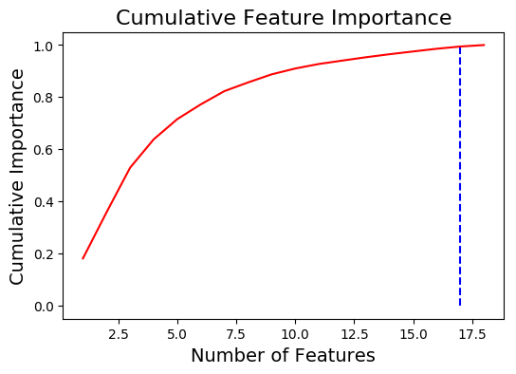
Features Selection
Important Steps
Clean the features
Clustering object type feature
Convert clustered features from categoric to numeric
Features selection to see the important feature
Set important features to X
Build into the model

Slide 9
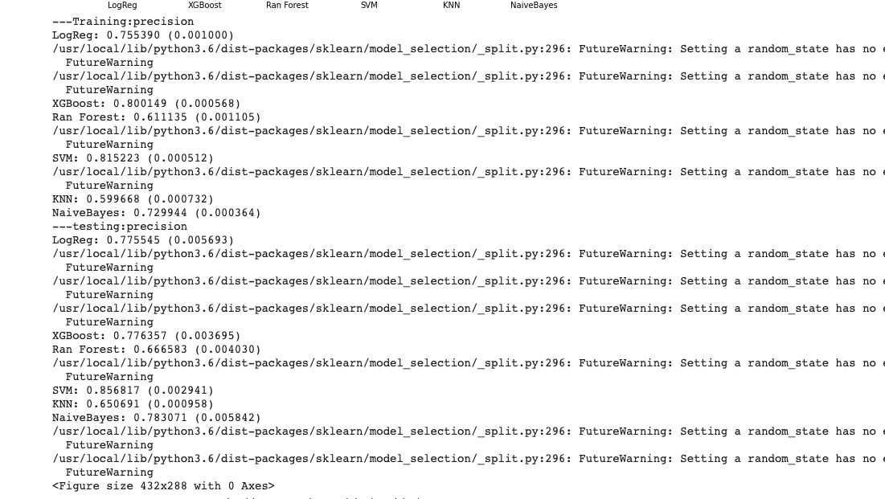
Modeling & Result
Precision Accuracy has increased with feature_selector
Algorithm | Testing: Precision
Logistic Reg | 77%
XGBoost | 77%
Random Forest | 66%
SVM | 85%
KNN | 65%
Naive Bayes | 78%
Highest F1 score= Random Forest- 57%

Slide 10
Challenges
IPO/Acquired information not provided
missing First Funding date- (would have given us better ground)
Lots of missing values
Define the target value to success or fail
Clean the features by their different condition

Slide 11
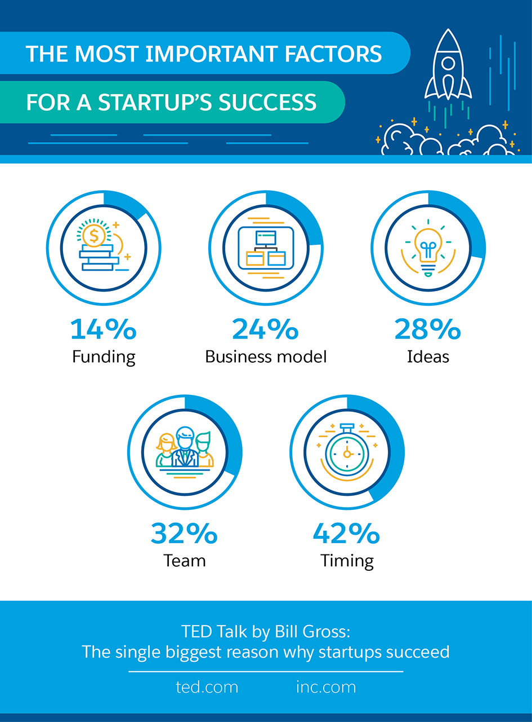

Conclusion
Predicting Failure and success of a startup takes a lot of features into consideration; of which 14% is funding.
If we had more Factors available like- business model, team and ideas; it would have helped in the prediction better.
Sometimes an Idea is everything!

